Slide 1
SVM
These slides are taken from Prof. Jiashi Feng’s slides.

Slide 2
Outlines
Unsupervised Feature Extraction (PCA, NMF,…)
Supervised Feature Extraction (LDA, …)
Clustering and Applications
Gaussian Mixture Model and Boosting
Support Vector Machine
Deep Learning
Some slides are from Xiaojin Zhu

Slide 3
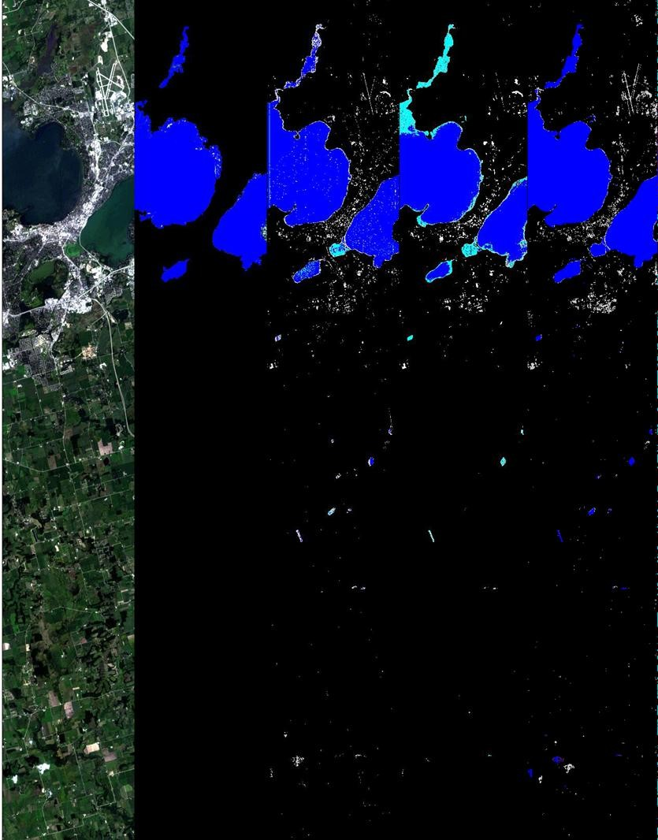
Lake Mendota, Madison, WI
Identify areas of land cover (land, ice,
water, snow) in a scene
Three algorithms:
Lake Mendota, Wisconsin
Scientist manually derived
Automatic best ratio
Support Vector Machine (SVM)
Classifier | Expert Derived | Automated Ratio | SVM
cloud | 45.7% | 43.7% | 58.5%
ice | 60.1% | 34.3% | 80.4%
land | 93.6% | 94.7% | 94.0%
snow | 63.5% | 90.4% | 71.6%
water | 84.2% | 74.3% | 89.1%
unclassified | 45.7%
Visible Image
Expert Labeled
Expert Derived
Automated SVM Ratio
Notes:
A supervised classification problem.
Problem: classify the land cover of a scene image into different categories.

Slide 4
Support vector machines
The state-of-the-art classifier
Class labels
denotes +1
denotes -1
How would you
classify this data?

Slide 5
Linear classifier
If all you can do is to draw a straight line, the ‘linear
decision boundary’…

Slide 6
Linear classifier
Another OK ‘decision boundary’

Slide 7
Any of these
would be fine..
..but which is the
best?

Slide 8
The margin
Margin: the width that the boundary can be increased
before hitting a data point

Slide 9
SVM: maximize margin
The simplest SVM (linear SVM) is the linear classifier
with the maximum margin
Linear SVM

Slide 10
SVM: linearly non-separable data
What if the data is not linearly separable?

Slide 11
SVM: linearly non-separable data
Two solutions:
Allow a few points on the wrong side (slack variables), and/or
Map data to a higher dimensional space, do linear
classification there (kernel)

Slide 12
SVM: more than two classes
N class problem: Split the task into N binary tasks:
Class 1 vs. the rest (class 2—N)
Class 2 vs. the rest (class 1, 3—N)
▪ …
Class N vs. the rest
Finally, pick the class that put the point furthest into
the positive region.

Slide 13
SVM: get your hands on it
There are many implementations
http://www.support-vector.net/software.html
http://svmlight.joachims.org/
You don’t have to know the rest of the class in order
to use SVM.
end of class
(But you want to know more, don’t you?)

Slide 14
The math version
Support vector machines

Slide 15
Vector
A vector W in d-dimensional space is a list of d
numbers, e.g. W=(-1,2)’
A vector is a vertical column. ’ is matrix transpose
Vector is a line segment, with arrow, in space
The norm of a vector ||W|| is its length
||W|| = sqrt(W’ W)
W
Inner product: X’Y = ΣX_{i}Y_{i}
What d-dimensional point X
makes W’ X = 0?

Slide 16
Lines
W’ X is a scalar (single number): X’s projection onto W
W’X=0 specifies the set of points X, which is the line
perpendicular to W, and intersects at (0,0)
W’X=1, or W’X-1=0
W’X=0
W’X=-1, or W’X+1 = 0
W
0
1/||W||
W’X=1 is the line parallel to W’X=0, shifted by 1/||W||
What if the boundary doesn’t go through origin?
Notes:
W^\top x_1 = 0, W^\top x_2 =1.
W^\top (x_2 – x_1) = 1.
Let y = x_2 – x_1, we have w^\top y = 1.
Let x_1 = 0, then w/\|w\| * \|y\| = y. Then w^\top y / \|w\|* \|y\| = y^\top y = \|y\|^2. y is not equal to zero and w^\top y = 1. Therefore, 1/\|w\| = \|y\|.

Slide 17
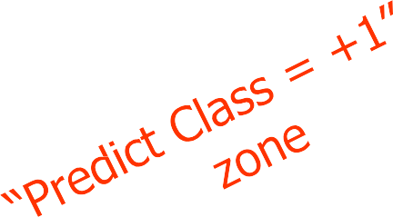
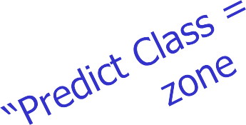
SVM boundary and margin
Want: find W, b (offset) such that
all positive training points (X,Y=1) in the red zone,
all negative ones (X, Y=-1) in the blue zone,
the margin M is maximized
Plus-Plane
Classifier Boundary
Minus-Plane
2/||W||
M=2/||W|| (why?)
How do we find such W,b?

Slide 18


SVM as constrained optimization
Variables: W, b
Objective function: maximize the margin M=2/||W||
Equiv. to minimize ||W||, or ||W||²=W’W, or ½W’W
•
•
Assume N training points (Xi, Yi), Yi = 1 or -1 Subject to each training point on the correct side (the
constraint). How many constraints do we have?
Plus-Plane
Classifier Boundary
Minus-Plane
2/||w||

Slide 19
SVM as constrained optimization
Variables: W, b
Objective function: maximize the margin M=2/||W||
Equiv. to minimize ||W||, or ||W||²=W’W, or ½W’W
•
•
Assume N data points (Xi, Yi), Yi = 1 or -1
Subject to each training point on the correct side (the
constraint). How many constraints do we have? N
W’Xi + b >= 1, if Yi=1
• W’Xi + b <= -1, if Yi=-1
we can unify them: Yi(W’Xi+b) >= 1
We have a continuous constrained optimization problem! What do we do?

Slide 20
SVM as QP
min_{W,b} ½ W’W
Subject to Yi (W’Xi + b) >= 1, for all i
Objective is convex, quadratic
Linear constraints
This problem is known as Quadratic Program (QP), for which efficient global solution algorithms exist.
Plus-Plane
Classifier Boundary
Minus-Plane
2/||W||

Slide 21
Non-separable case
What about this?
Can we insist on Yi (W’Xi + b) >= 1, for all i?

Slide 22
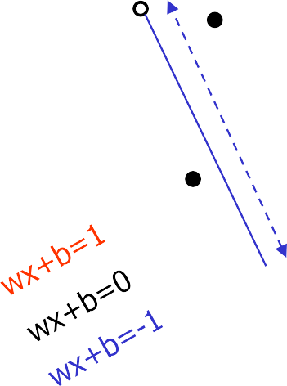
Trick #1: slack variables
Relax the constraints – allow a few “bad apples”
For a given linear boundary W, b, we can compute how far off into the wrong side a bad point is
^{ε}11
ε₂
ε₇
Here’s how we relax the constraints:
Yi (W’Xi + b) >= 1- ε_{i}

Slide 23

Trick #1: SVM with slack variables
min_{W,b,ε} ½ W’W + C ∑_{i} ε_{i}
Subject to
Trade-off parameter
Yi (W’Xi + b) >= 1- ε_{i} for all i
ε_{i}>=0 for all i (why?)
^{ε}11
ε₂
ε₇

Slide 24
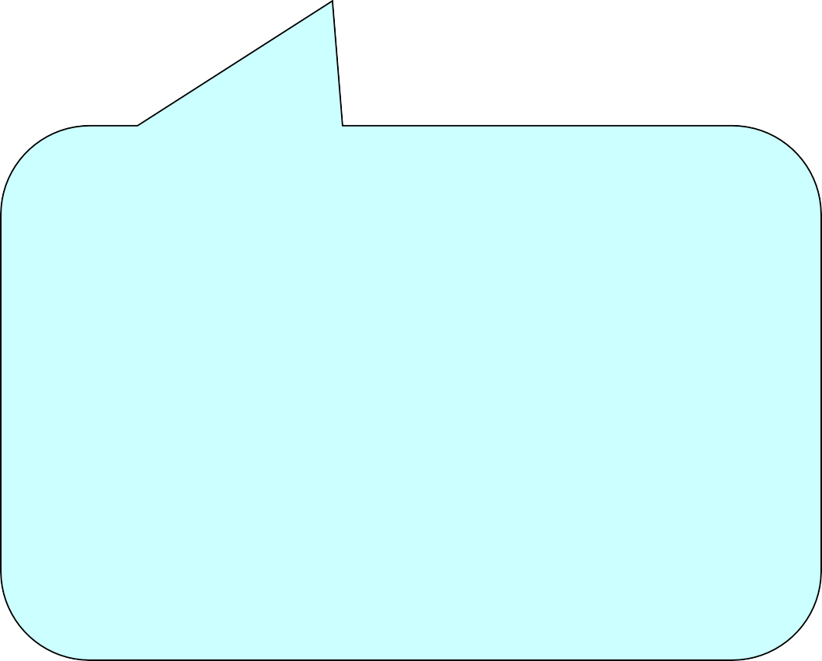
Trick #1: SVM with slack variables
min_{W,b,ε} ½ W’W + C ∑_{i} ε_{i}
Subject to
Trade-off parameter
Yi (W’Xi + b) >= 1- ε_{i} for all i
ε_{i}>=0 for all i
Originally we optimize variables
W (d-dimensional vector), b
Now we optimize W, b, ε₁ … ε_{N}
Now we have 2N constraints
^{ε}11
ε₇
Still a QP (soft-margin SVM)

Slide 25
Another look at non-separable case
Here’s another non-separable dataset, in 1-
dimensional space
We can of course use slack variables… but here’s another trick!
x=0

Slide 26
Trick #2: Map data to high dimensional space
We can map data x from 1-D to 2-D by x → (x, x²)
x=0

Slide 27
Trick #2: Map data to high dimensional space
We can map data x from 1-D to 2-D by
x → Φ(x)=(x, x²)
•Now the data is linearly separable in the new space!
•We can run SVM in
the new space
•The linear boundary in the new space corresponds to a non- linear boundary in the old space
x=0

Slide 28
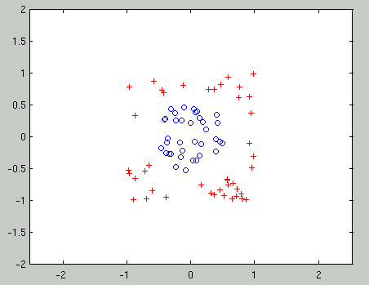
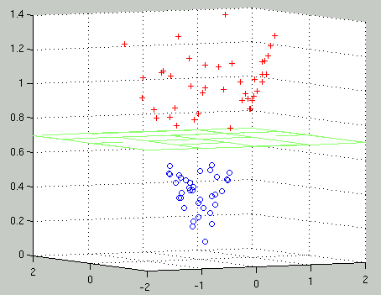
Another example
(x₁, x₂ ) ⇒ (x₁, x₂ ,
x² + x² )
1 2

Slide 29
Trick #2:Map data to high dimensional space
In general we might want to map an already high- dimensional X=(x₁, x₂, …, x_{d}) into some much higher, even infinite dimensional space Φ(x)
Problems:
How do you represent infinite dimensions?
We need to learn (amount other things) W, which lives in the new space… learning a large (or infinite) number of variables in QP is not a good idea.
x=0

Slide 30
Trick #2: kernels
We will do several things:
Convert it into a equivalent QP problem, which does not use W, or even Φ(X) alone!
It only uses the inner product Φ(X)’ Φ(Y), where X and Y are two training points. The solution also only uses such inner product
It still seems infeasible to compute for high (infinite)
dimensions
But there are smart ways to compute such inner
product, known as kernel (a function on two var.)
kernel(X,Y) ⬄ inner product Φ(X)’ Φ(Y)
Why should you care:
One kernel, one new (higher dimensional) space
You will impress friends at cocktail parties

Slide 31
Prepare to bite the bullet…
Here’s the original QP formula
min_{W,b} ½ W’W
Subject to Yi (W’Xi + b) >= 1, for all i (N constraints)
Remember Lagrange multipliers?
L = ½ W’W – Σai [Yi (W’Xi + b) – 1]
Subject to ai >= 0, for all i
We have them here because those are inequality constraints
We want the gradient of L to vanish with respect to W, b, a. Try this and you’ll get
W = Σai Yi Xi
Σai Yi = 0
Put them back into the Lagrangian L

Slide 32
Biting the bullet
max_{{ai}} Σai – ½ Σ_{i,j}ai aj Yi Yj Xi’ Xj
Subject to
ai >= 0, for all I
Σai Yi = 0
This is an equivalent QP problem (the dual)
Before we optimize W (d variables), now we optimize
a (N variables): which is better?
X only appears in the inner product

Slide 33
Biting the bullet
max_{{ai}} Σai – ½ Σ_{i,j}ai aj Yi Yj Φ(Xi)’ Φ(Xj)
Subject to
ai >= 0, for all I
Σai Yi = 0
This is an equivalent QP problem
•
•
If we map X to
new space
Φ(X)
Before we optimize W (d variables), now we optimize
a (N variables): which is better?
X only appears in the inner product

Slide 34
What’s special about kernel
Say data is two dimensional: s=(s1,s2)
We decide to use a particular mapping into 6 dimensional space
Φ(s)=(s1², s2², √2 s1s2, s1, s2, 1)
Let another point be t=(t1,t2).
Φ(s)’ Φ(t)=s1² t1² + s2² t2² + 2 s1s2t1t2 + s1t1 + s2t2 + 1

Slide 35
What’s special about kernel
Say data is two dimensional: s=(s1,s2)
We decide to use a particular mapping into 6 dimensional space
Φ(s)=(s1², s2², √2 s1s2, √2 s1, √2 s2, 1)
Let another point be t=(t1,t2).
Φ(s)’ Φ(t)=s1² t1² + s2² t2² + 2 s1s2t1t2 + 2 s1t1 + 2 s2t2 + 1
Let the kernel be K(s,t) = (s’t+1)²
Verify that they are the same. We saved
computation.

Slide 36

Kernels
You ask: “Is there such a good K for any Φ I pick?”
The inverse question: “Given some K, is there a Φ so that K(X,Y) = Φ(X)’ Φ(Y)?”
Mercer’s condition: the inverse question is true…
This is positive semi-definiteness, if you must know
Φ may be infinite dimensional; we may not be able to explicitly write down Φ

Slide 37
Some frequently used kernels
Linear kernel: K(X,Y) = X’Y
Quadratic kernel: K(X,Y) = (X’Y+1)²
Polynomial kernel: K(X,Y) = (X’Y+1)^{n}
Radial Basis Function kernel: K(X,Y) = exp(- ||X-Y||²/σ)
Many, many other kernels
Hacking with SVM: create various kernels, hope their space Φ is meaningful, plug them into SVM, pick the one with good classification accuracy (equivalent to feature engineering)
Kernel summary: QP of size N, nonlinear SVM in the original space, new space possibly high/infinite dim, efficient if K is easy to compute
Kernel can be combined with slack variables

Slide 38
Why the name “support vector machines”
max_{{ai}} Σai – ½ Σ_{i,j}ai aj Yi Yj K(Xi, Xj)
Subject to
ai >= 0, for all I
Σai Yi = 0
The decision boundary is
f(Xnew)=W’ Xnew + b= Σai Yi Xi’ Xnew + b
In practice, many a’s will be zero in the solution!
Those few X with a>0 lies on the margin (blue or
red lines), they are the ‘support vectors’

Slide 39
What you should know
The intuition, where to find software
Vector, line, length
Margin
QP with linear constraints
How to handle non-separable data
Slack variables
Kernels ⬄ new feature space
Ref: A Tutorial on Support Vector Machines for Pattern
Recognition (1998) Christopher J. C. Burges

